Slide 1
Data Access with ADO.NET
Accessing SQL Server and OLEDB from .NET
October 21, 2016

Slide 2
Agenda
Data Access Models – Connected, Disconnected and ORM
ADO.Net Architecture and Providers
Accessing SQL Server (Connected Model)
Accessing Other databases

Slide 3
Data Access Models

Slide 4
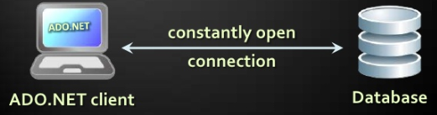
Connected Model
Connected Data Access Model
Applicable to an environment where the database is constantly available
Too much effort to issue commands by hand

Slide 5
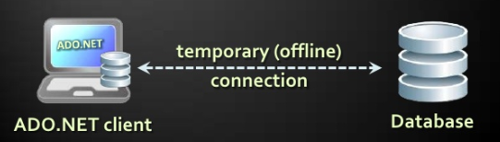
Disconnected Model
Disconnected Data Access Model
A subset of the Central database is copied locally at the client and he works with the copy
Database synchronization is done offline
SDK, compilers, tools

Slide 6
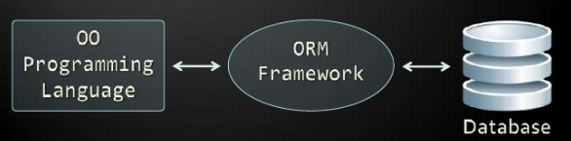
ORM Model
ORM Data Access Model
Maps database tables to classes and objects
Objects can be automatically persisted in the database
Can operate in both connected and disconnected modes

Slide 7
ORM Model: Benefits and Problems
ORM model benefits
Increased productivity: Writing less code
Use Objects with associations instead of tables and SQL commands
Integrated Object Query mechanism
ORM model drawbacks
Less flexibility: SQL is automatically generated
Performance issues (sometimes)

Slide 8
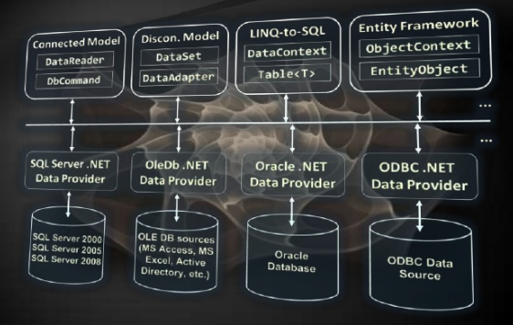
ADO.NET Architecture

Slide 9
Why ADO.NET?
ADO.NET is standard class library for accessing database, processing data and XML
An API for working with data in .NET
Supports connected, disconnected and ORM data models
Excellent integration with LINQ, XML and WCF
Allows executing SQL in RDBMS systems
DB connections, data readers, db commands
Supports the ORM approach
LINQ-to-SQL and ADO.NET Entity Framework

Slide 10
Namespaces in ADO.NET?
System.Data
ADO.Net core classes
System.Data.Commom
Common classes for all ADO.NET technologies
System.Data.Linq
LINQ to SQL framework classes
System.Data.Entity
Entity Framework classes
System.Xml
Xml processing classes

Slide 11
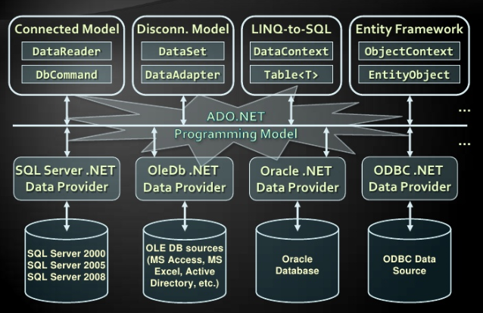
Components of ADO.NET?

Slide 12
Data Providers in ADO.NET
Data Providers are collection of classes that provide access to various databases
For different RDBMS systems different Data Providers are available
Each provider uses vendor specific protocols to talk to the database server
Data Providers define several common objects:
Connection – to connect to the database
Command – to execute an SQL command
DataReader – to retrieve data
Entity Framework Support (optionally)

Slide 13
Data Providers in ADO.NET
Several standard ADO.Net data providers come as part of ADO.NET
Sqlclient – Accessing SQL server
oleDB – Accessing standard OLD DB data sources
Odbc – accessing standard DDBC sources
Oracle – accessing Oracle database
Third party data providers are available for –
MySQL, PostgreSQL, Interbase, DB2, SQLite
Other RDBMS systems and data sources

Slide 14
Third Party Data Providers in ADO.NET
ADO.NET driver for MySQL (Connect/NET)
https://www.mysql.com/products/connector/
Supports Entity Framework
Oracle Data Provider for .NET (ODP.NET)
DotNet Provider for Postgrace SQL

Slide 15
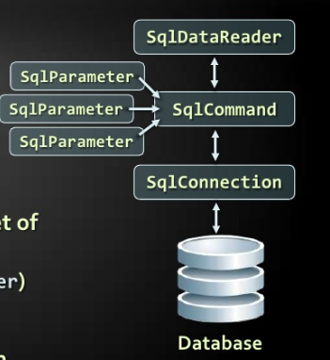
ADO.NET connected model
Retrieving data in connected model
Open a connection (SqlConnection)
Execute Command (SqlCommand)
Process the resultset of the query by using Reader (SqlReader)
Close the Reader
Close the Connection

Slide 16
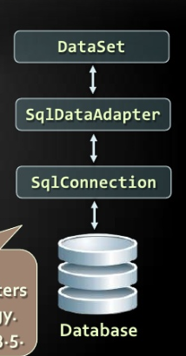
ADO.NET disconnected model
Disconnected model – Data is cached in dataset
Open a connection (SqlConnection)
Fill Dataset (using SqlAdapter)
Close the Connection
Modify the Dataset
Open Connection
Update Changes
Close Connection

Slide 17
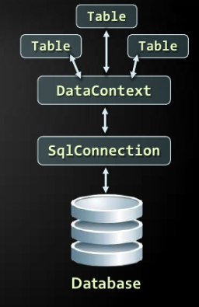
ADO.NET LINQ to SQL
LINQ to SQL is ORM Framework for SQL server
Create Object model mappings to Database
Open a Data Context
Retrieve data using LINQ/ modify the tables in data context
Persist the data context changes into the DB
Connection is auto-closed

Slide 18
SQLClient Data Provider

Slide 19
SQLClient Data Provider
SqlConnection
Establish database connection to SQL Server
SqlCommand
Executes Sql commands on SQL Server through an established connection
Could accept parameters (SqlParameter)
SqlDataReader
Retrieves data(recordset) from Sql Server as a result of Sql query execution

Slide 20

SqlConnection class
SqlConnection holds connection to SQL Server database
Requires valid connection string
ConnecionString Example
DataSource=(local)\SQLEXPRESS; Initial Catalog=Northwind; Integrated Security=SSPI;
Connection to SQL Server

Slide 21
Connection String
Database connection string
Defines the parameters needed to establish the connection with database
Main parameters for SQL Connection
Provider – Name of the DB provider
DataSource/Server – server name/IP address + database instance name
Database/ Initial catalog – database name
UserId/Password - Credentials

Slide 22
Connection String
Main parameters for SQL connection
AttachDBFileName = somedb_mdf
Attaches a local database file for startup
Supported by SQL Express only
Server=Server_name\database_instance or “.” or (local) or “some_server”
Database instance is “MSSQL” or “SQLEXPRESS” or other SQL Server instance name
Integrated Security=true/false

Slide 23
Working with Sqlconnection
Explicitly opening and closing connection
Open(), Close() methods
Works through the connection pool
Implicitly opening and closing connection
Done automatically by DataAdapters, DataContexts, and ObjectContexts
Connections are Idisposable objects
Can be managed with using construct

Slide 24
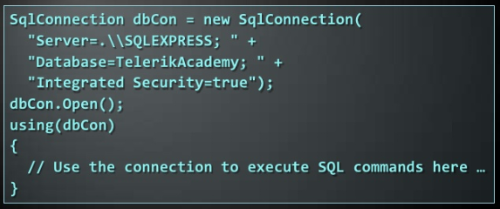
Sqlconnection Example
Creating and Opening Connection to SQL Server Database

Slide 25
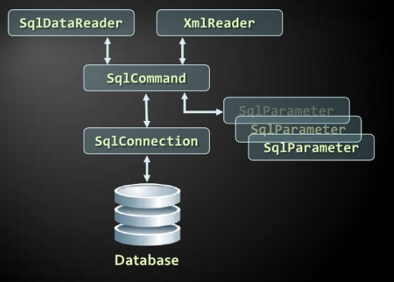
ADO.Net classes for connected data model

Slide 26
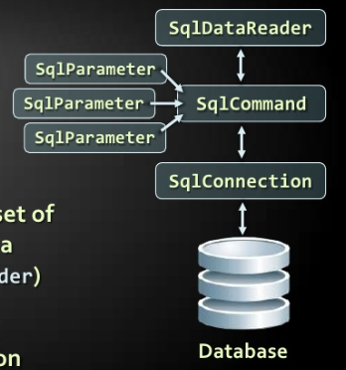
SQL Client and Connected Data Model
Retrieving data in connected data model
Open a Connection (SqlConnection)
Execute Command (SqlCommand)
Process the resultset of query by using Data Reader (SqlDataReader)
Close the Reader
Close the Connection

Slide 27
SqlCommand
Executes an SQL statement or a stored procedure
More important properties
Connection- gets/sets the SqlConnection of the command
CommandType - the type of command
CommandType.StoredProcedure
CommandType.TableDirect
CommandType.Text
CommandText – The body of the sql query or the name of stored procedure
Parameters

Slide 28
SqlCommand
More important methods
ExecuteScalar()
Returns a single value (the value in the first column of the first row of the resultset)
The returned value is System.Object but can be casted to the actual return type
CommathndType.Text
ExecuteReader()
Returns SqlDataReader
It is a cursor over the returned records (resultset)
Command Behavior – assign some options

Slide 29
SqlCommand
More important methods
ExecuteNonQuery()
Used for non-query SQL commands e.g. INSERT, DELETE
Returns the number of affected rows (int
ExecuteXmlReader()
Returns recordset as Xml
Returns XmlReader
Supported by SqlClientProvider only

Slide 30
SqlDataReader Class
SqlDataReader retrieves a sequence of records (cursor) returned as result of an SQL command
Data is available for reading only (can’t be modified)
Forward-only row processing ( no move back)
Important properties and methods
Read() – moves the cursor forward and returns false if there is no next record
Item(Indexer)- Retrieves value in the current record by given column name or index
Close()-Closes the cursor and releases resources

Slide 31
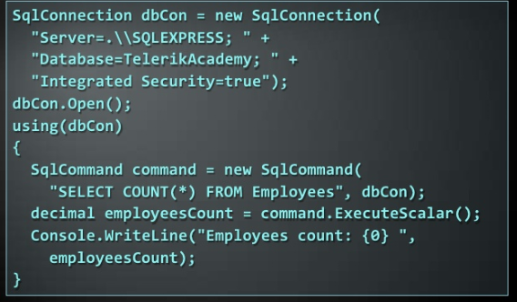
SqlCommand Example

Slide 32
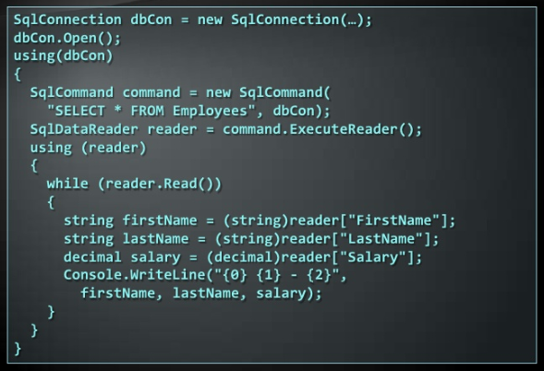
SqlDataReaderExample

Slide 33
Demo: Using SqlCommand and SqlDataReader

Slide 34
SqlParameter Class
What are SqlParameters?
Sql queries and stored procedures can have input and output parameters
Access through the parameter property of the SqlCommand class
Important properties and methods
ParameterName – Name of the parameter
DbType - SQL Type (Nvarchar, TimeeStamp…)
Size – Size of the data type (if applicable)
Directioin – input/output

Slide 35
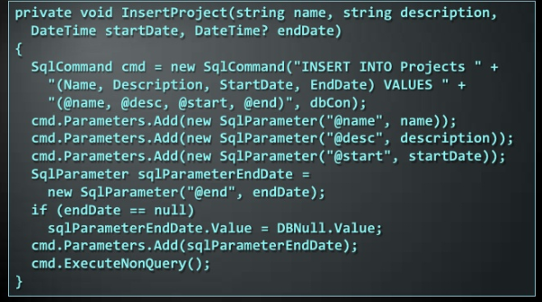
Parameterized Commands - Example

Slide 36

Primary key retrieval
Retrieval of an automatically generated primary key is specific to each database server
In SQL Server, IDENTITY column is used
Obtained by executing following query
Select @@
Example of obtaining an automatically generated primary key in ADO.NET-

Slide 37
Demo: Parametetized Queries

Slide 38
Connecting to Non-Microsoft Databases

Slide 39
Connecting to Non-Microsoft Databases
ADO.NET supports accessing various databases via their Data Providers:
OLE DB- Supported internally in ADO.NET
Access any OLEDB –compliant data source
E.g. MS-Access,MS-Excel, MS-Project, MS-Exchange, Windows Active Directory, text files..
Oracle – supported internally in ADO.NET
MySQL – third party data provider
PostgraceSQL - third party data provider

Slide 40
ADO.NET Data Interfaces
ADO.NET Data Providers implements the following interfaces
IDbConnection
IDbCommand, IDataParameter
IDataReader
IDataAdapter

Slide 41
ADO.NET Base Classes
ADO.NET provides following base classes
DbConnection
DbCommand, DbParameter
DbDataReader
DbTransaction
DbParameterCollection
DbDataAdapter
DbCommandBuilder
DbConnectionStringBuilder
DbDataPermission

Slide 42

OLDDBDataProvider
OleDbConnection – Establishes a connection to an OLEDB data source
OleDbCommand – Executes an SQL commands throuogh an OLEDB connection to DB
OleDbParameter – parameter for a command
OleDbDataReader – to retrieve data from command, executed through OLEDB

Slide 43
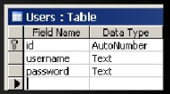

Connecting to OLEDB - Example
Suppose we have MS-Access Db – c:\Library.mdb
We have the table – Users
We use “Microsoft Jet 4.0 Provider” to connect in ADO.NET through OLEDB
We create a connection string component -

Slide 44
Demo: Connecting to MS-Access Database

Slide 45

Thank You!
Prashant Kulkarni
Technical Lead
Mobile: +91 9890913122
Desk: +91 20 66046341
Prashant.kulkarni@xoriant.com
www.xoriant.com
India
Mumbai
4th Floor, Nomura
Powai , Mumbai 400 076
Pune
5th Floor, Amar Paradigm
Baner, Pune 411 045
Kolkata
2B, 12th Floor, Tower ‘C’
Rajarhat, Kolkata 700 156
US – Corporate Headquarters
1248 Reamwood Avenue,
Sunnyvale, CA 94089
Phone: (408) 743 4400
343 Thornall St 720
Edison, NJ 08837
Phone: (732) 395 6900
UK
20 Broadwick Street
Soho, London
W1F 8HT, UK
89 Worship Street
Shoreditch,
London EC2A 2BF, UK
Phone: (44) 2079 938 955
Bangalore
4th Floor, Kabra Excelsior,
80 Feet Main Road, Koramangala 1st Block,
Bengaluru (Bangalore) 560034
Gurgaon
A/373rd Floor, Sigma Center
Gurgaon, Haryana 122 011s

